Slide 1
Biodiversity in Natural Parks
A Data Science project

Slide 2
Scope
The present Data Science project aims to provide meaningful insight about the state of species present today in a set of Natural Parks in the USA.
In order to achieve this, we proposed a set of questions that allows us to gather, analyze, conclude, visualize and present a picture of the conservation status of a wide variety of species that may be varios degrees of risk of extintion.

Slide 3
Questions
1. What endangered species are present today in natural parks?
2. Which species are the most endangered today?
3. What are the most common and least common species found in national parks today?

Slide 4
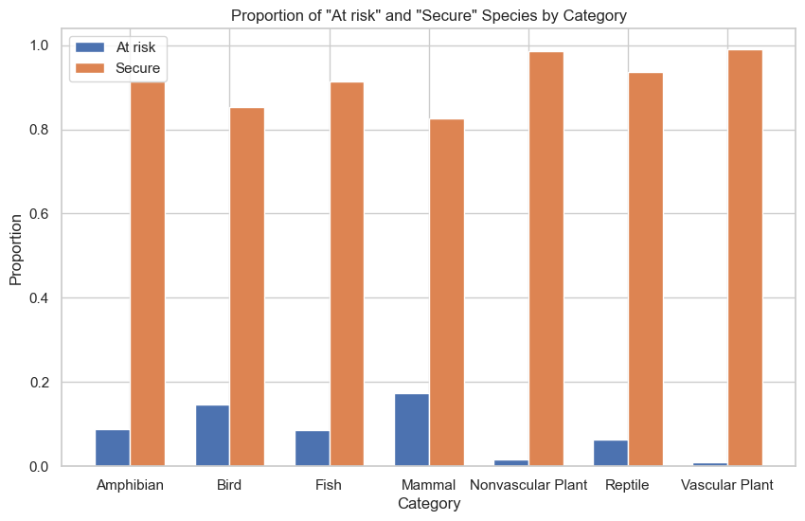
Proportion of Risk Assesment of Species by Category

Slide 5
Chi-2 test for Risk Assesment analysis

